Slide 1
Rock, paper, scissors, lizard, Spock.
Design Problem 2
While waiting for class to start:
Download and open the Jupyter Notebook (.ipynb) for Lecture 2.2.1 and 2.2.2
You may also use this lecture’s JupyterHub link instead (although opening it locally is encouraged).
Upcoming:
Reflection 2 released Friday @ 11 AM
Lab 3 released Friday @ 12 PM
Lab 2 deadline this Friday @ 11 PM
PRA (Lab) on Friday @ 2PM this week (ONLINE)

Slide 2
Agenda
Problem Background
Learning Objectives
Coding

Slide 3
Reflection Update
5/54 students consider themselves intermediate, everyone else beginner or no experience (no students considered themselves advanced)
2/3 on Windows, 1/3 on Mac
Main challenges
functions, return, local vs. global scope
Want more examples and practice
Design problems, practice problems, but more in-class upcoming!

Slide 4
Our problem background starts in a famous TV show apartment…

Slide 5


Slide 6
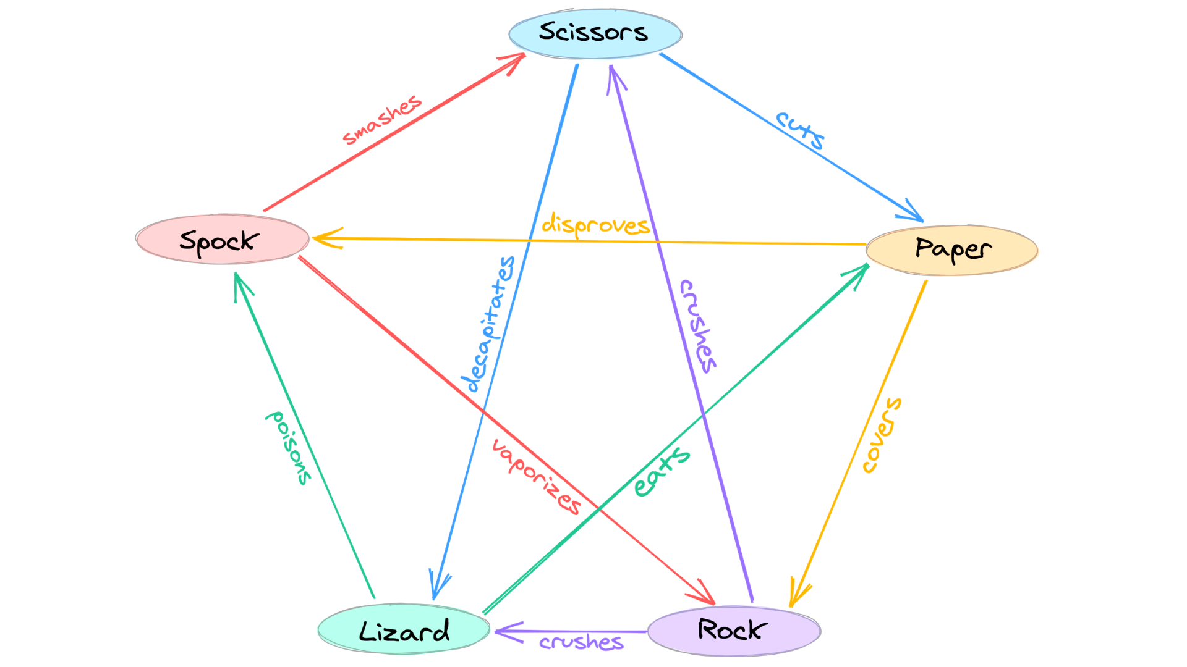
Background
Use conditional statements and imported modules to create a basic computer game!
Goal: Write a Python program that using conditional statements and user input to play Rock-Paper-Scissors-Lizard-Spock against a computer program with random choice selection.

Slide 7
Background
Practice using many conditional statements.
Practice with user input.
Practice creating custom functions.
Practice with built-in libraries.

Slide 8
Engineering Design Process
Learn to define the problem.
Practice defining test cases.
Develop an algorithm plan (i.e. a workflow!).
Program your solution and debugging.

Slide 9
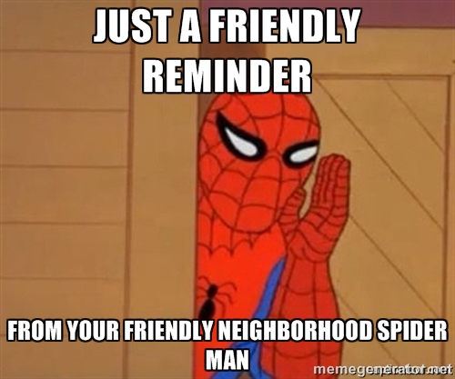
Some friendly reminders…

Slide 10

RECAP: Making Choices
statements
Sequential structure
statements
Conditional structure
if
True
condition
statements
statements
statements
False
statements

Slide 11


Adding the elif (else if) statement
The most general form of the if conditional statement is:
if condition1:
body1
elif condition2:
body2
elif conditionN:
bodyN
else:
other_body
Note the colons (:) and the indents!
ONLY 1 body will be executed.
if statement is True, execute body1, exits if structure
if statement is False, continue to elif statement
elif statement is True, execute elif body, exits if structure
elif statement is False, continue to next elif statement
All if’s and elif’s are False, execute else statement

Slide 12
Making Choices
statements
True
if
condition
Conditional structure
False
statements
elif
True
condition
statements
False
else
statements

Slide 13
Function Definitions
Definition
Function Name
Colon
def function_body(parameters):
body
Indent
(parameter1,
parameter2, …)
What is in the body?

Slide 14
Function Definitions
def function_body(parameters):
1. “““DOCSTRING””” (optional)
2. Code the does the thing
3. return [expression]
The return statement is options and if it is not included, it’s the same as writing return None

Slide 15
Calling Functions
In Python names of variables and functions use low case and underscores.
function_name
Function_Name
FunctionName
The general form of a function call:
Terminology
argument: a value given to a function.
pass: to provide an argument to a function.
call: ask Python to execute a function (by name).
return: give a value back to where the function was called from.
function_name(arguments)

Slide 16
Input
Python has a built-in function named input for reading text from the user.
The general form of a input function call:
The argument is the text you want displayed to the user.
“What is your name?”
The value returned by the input function is always a string.
input(argument)

Slide 17
String Comparisons
Boolean comparisons can also be applied to strings, whether single characters or sets of characters
Compare two strings by their dictionary order, comparing letter by letter
Description | Operator | Example | Result of example
equality | == | 'cat' == 'cat' | True
inequality | != | 'cat' != 'Cat' | True
less than | < | 'A' < 'a' | True
greater than | > | 'a' > 'A' | True
less than or equal | <= | 'a' <= 'a' | True
greater than or equal | >= | 'a' >= 'A' | True

Slide 18
Importing Functions and Modules
The general for of an import statement is:
import module_name
To access a function within a module:
module_name.function_name

Slide 19
Rock, paper, scissors, lizard, Spock.
Design Problem 2

